Slide 1


Lesson 14 The Middle Ages
UNIT 3

Slide 2

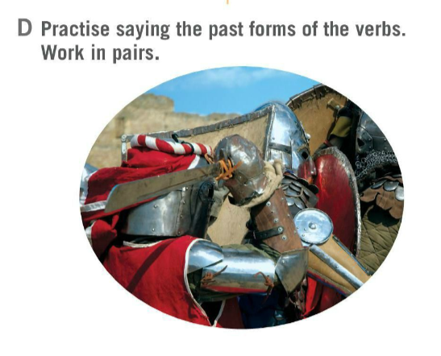

Solve the riddle.
What is the frutiest subject at school?
History – because it’s full of dates!
Did you answer correctly?
What is your favourite subject?
Do you like history?
How often do you study history?

Slide 3
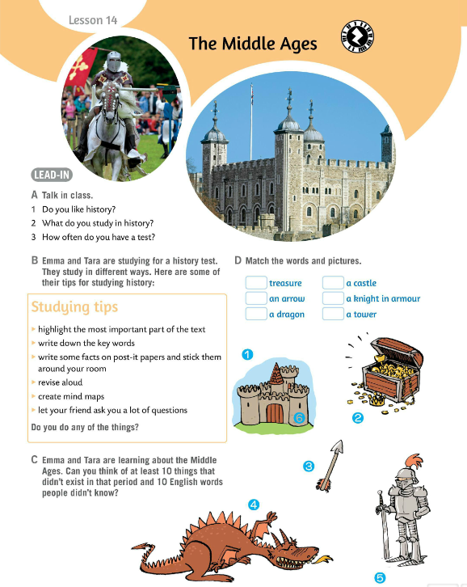
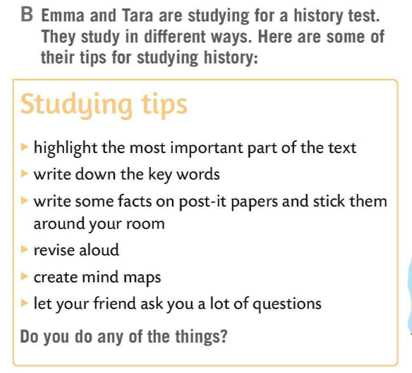
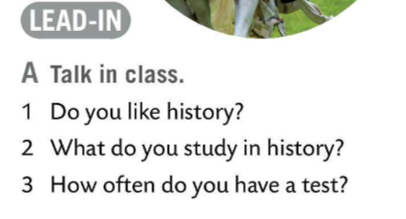
Talk to your friend. Ask questions from Task A.
Emma and Tara are studying for a history test. They study in different ways.
Read some of their tips for studying history in Task B.
Emma and Tara are learning about the Middle Ages.
Can you think of at least 10 things that didn’t exist in that period and 10 English words people didn’t know.
Share your answers with the class. Write down some of the answers.

Slide 4
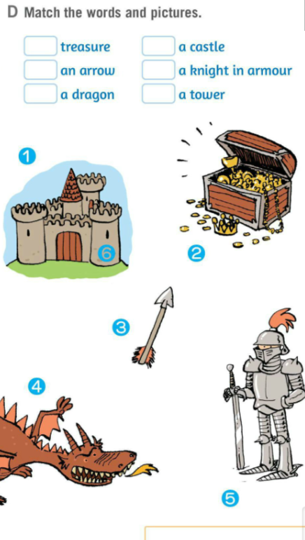
Match the words and pictures in Task D.
Check.
2
1
3
5
Translate:
treasure
a bow and an arrow
a dragon
a castle
a knight in armour
a tower
enemies
conquer
an abbey
pray
torunaments
nobles
common people
4
6
blago
luk i strijela
zmaj
dvorac
vitez u oklopu
kula, utvrda
neprijatelji
osvojiti
samostan
moliti se
viteški turniri
plemstvo
puk

Slide 5
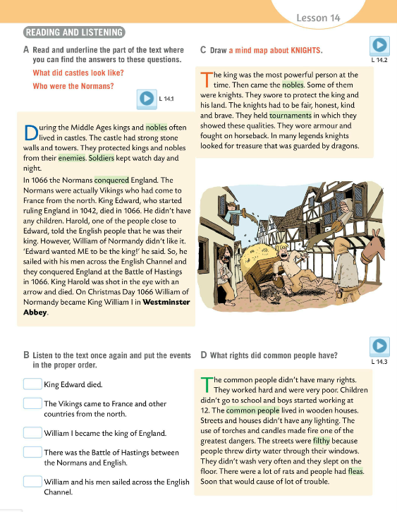

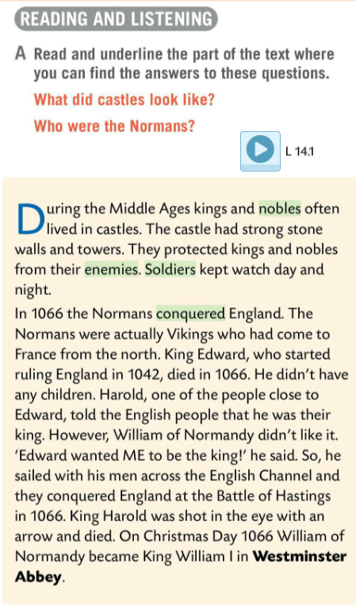
Listen to the recording.
Read the text. Underline the part of the text where you can find the answers to these questions.
1 What did the castles look like?
2 Who were the Normans?
Check.
1 The castles had strong stone walls and towers.
2 The Normans were actually Vikings who had come to France from the north.

Slide 6
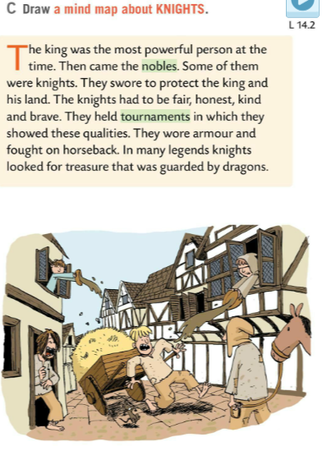
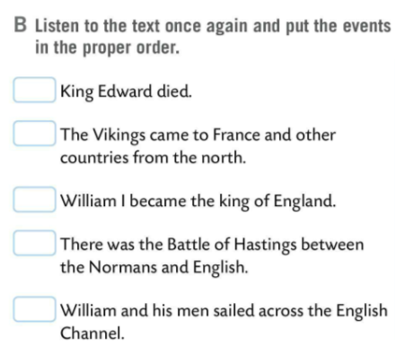
Listen to the recording once again. Put the events in the proper order.
Check.
Listen again. Try to memorize at least three things about KNIGHTS.
2
1
Read the text. Draw a mind map about KNIGHTS.
Present your mind map to the class.
5
4
3
Find at least 4 regular and 4 irregular verbs in past simple in the two texts. Write them in the table.

Slide 7
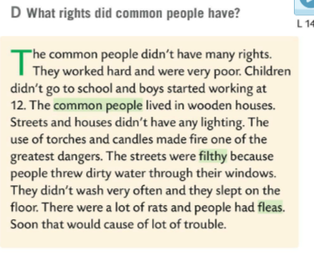
Listen to the recording and answer the question.
1 What rights did common people have?
Check.
1 The common people didn’t have many rights. They worked hard and were very poor.
Practise reading the text and then read it out loud.

Slide 8
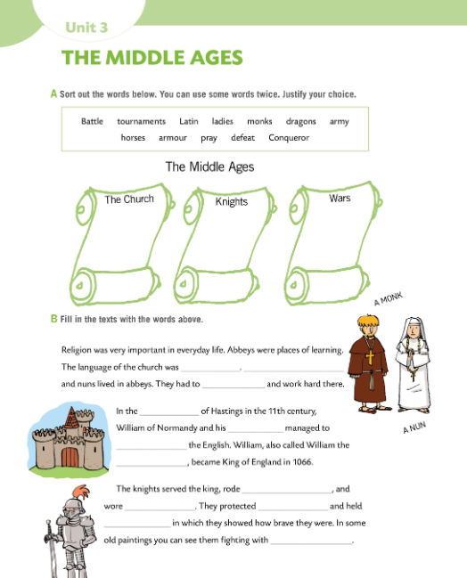

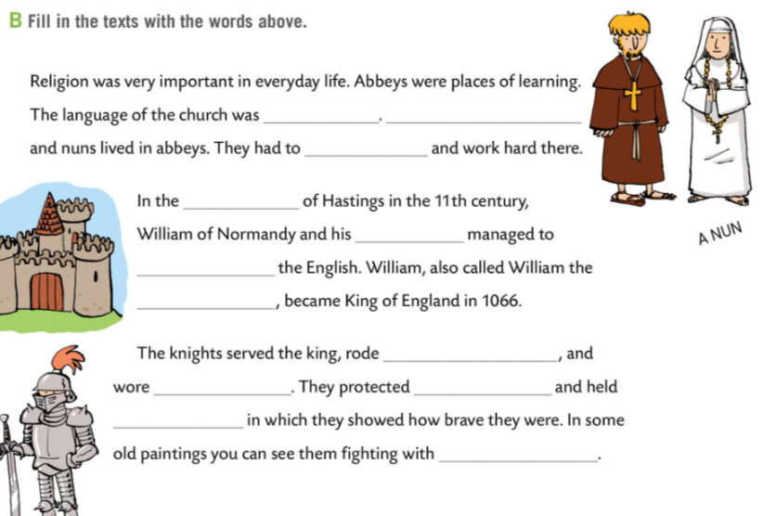
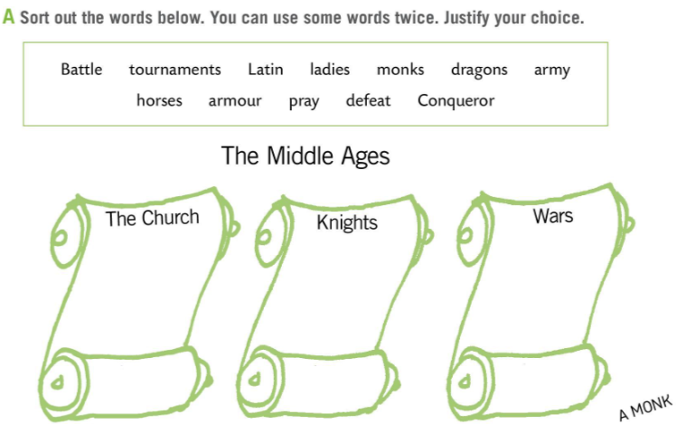
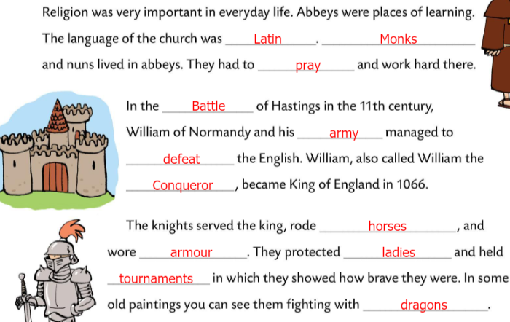
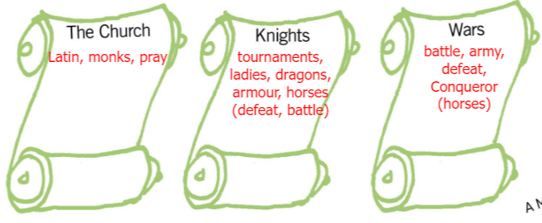
Workbook page 72.
Sort out the words below. You can use some words twice. Justify your choice.
Check.
Fill in the texts with the words from Task B.
Check.

Slide 9
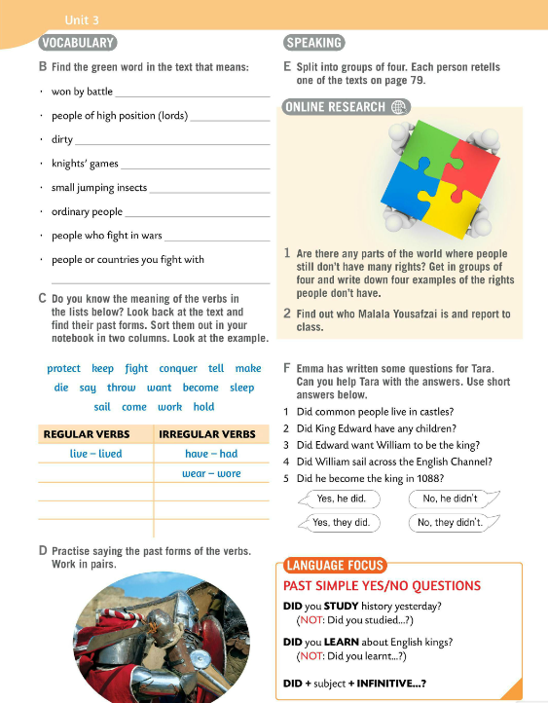
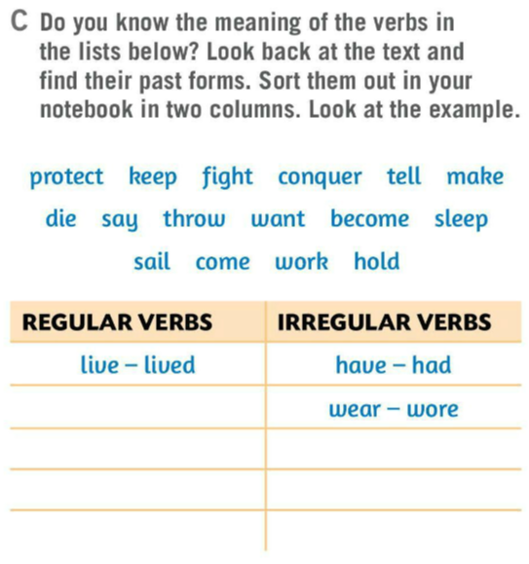
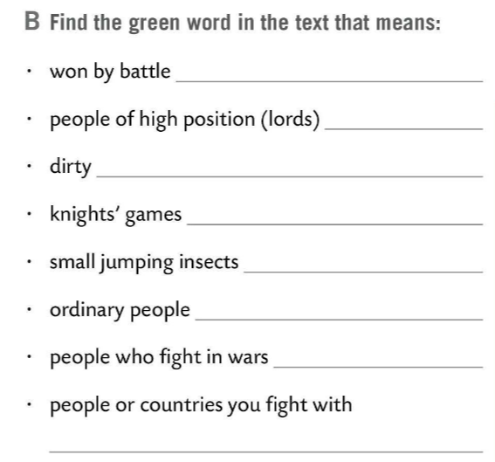
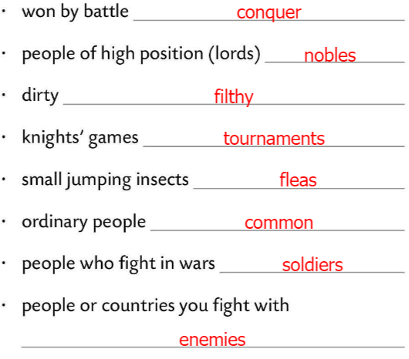
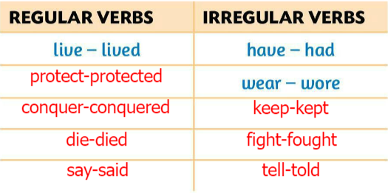
Do Task B. Find the green word in the text that means…
Check.
Do Task C.
Translate the verbs in the list. Find their past forms in the text. Sort them out in your notebook in two columns.
Look at the example.
Check.
Work in pairs. Practise saying the past forms of the verbs.

Slide 10
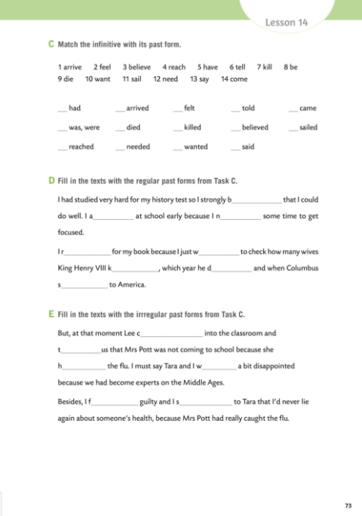
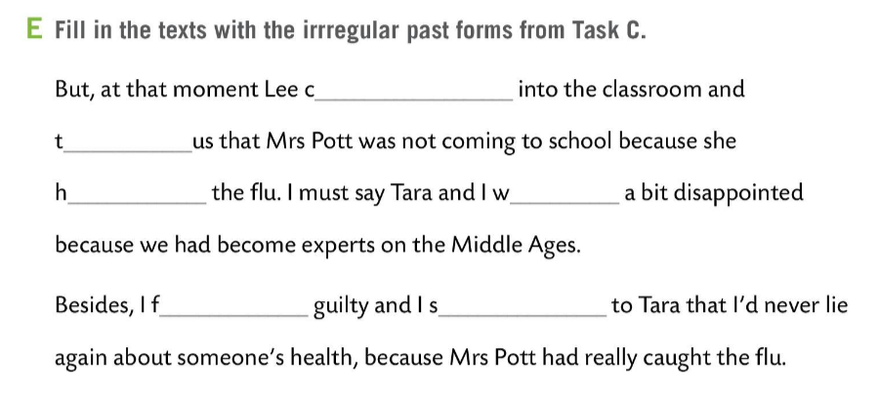
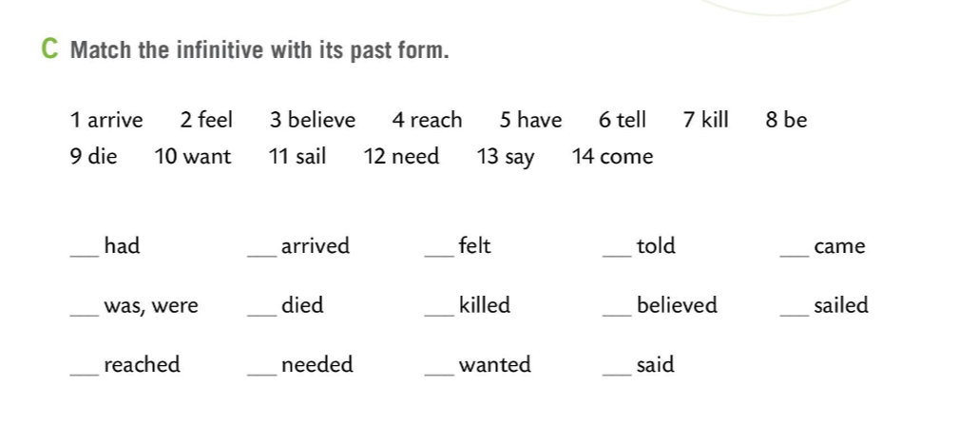
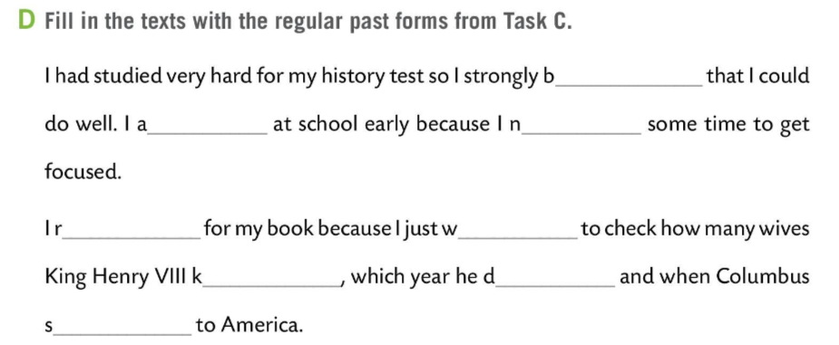
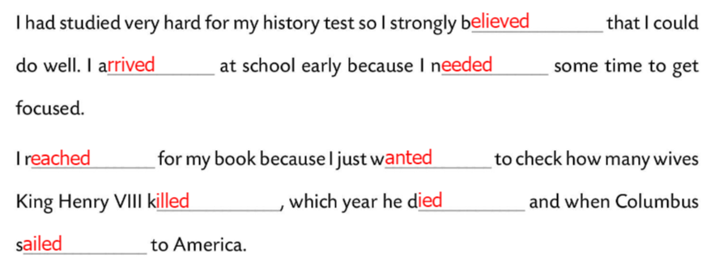
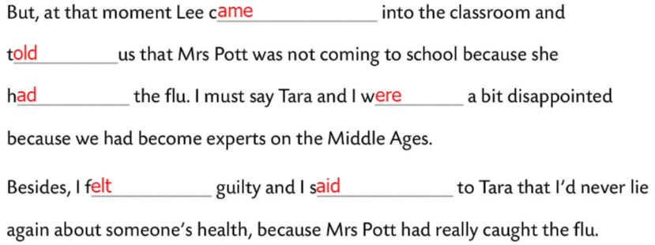
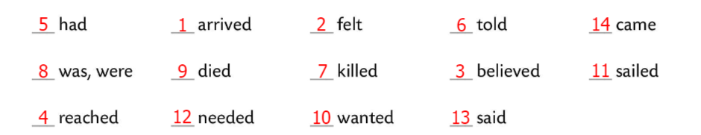
Workbook page 73.
Match the infinitive in Task C with its past form.
Check.
Fill in the texts with the regular past forms from Task C.
Check.
Fill in the texts with the irregular past forms from Task C.
Check.

Slide 11
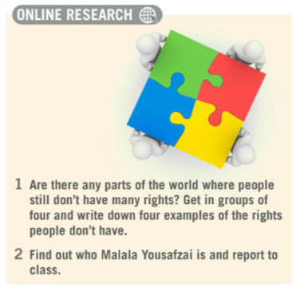
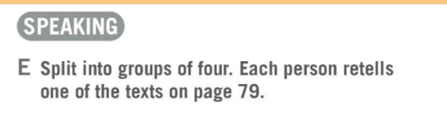
Split into groups of four. Each person retells one of the texts on page 79.
Are there any parts of the world where people still don’t have many rights? Get in groups of four and write down four examples of the rights people don’t have.
Find out who Malala Yousafzai is and report to class.

Slide 12
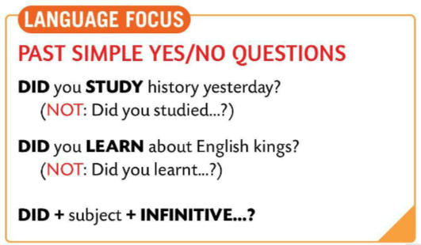
LANGUAGE FOCUS
YES/NO questions in past simple
DID you STUDY history yesterday?
(NOT: Did you studied…?)
DID you LEARN about Croatian kings?
(NOT: Did you learned about…?)
DID + subject + INFINITIVE…?

Slide 13
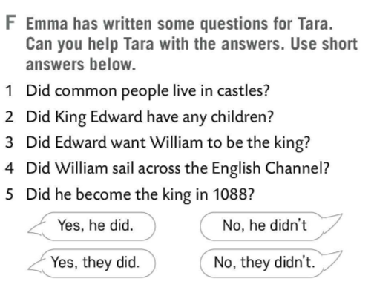
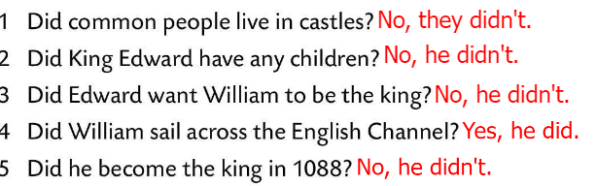
Emma has written some questions for Tara. Can you help Tara with the answers? Use short answers below.
Check.
Play the game and revise the vocabulary.
https://wordwall.net/play/511/121/913

Slide 14
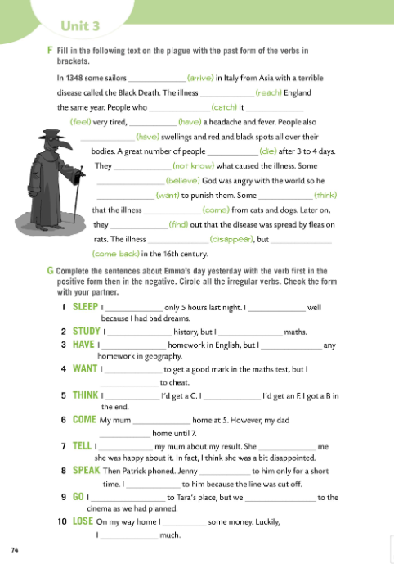
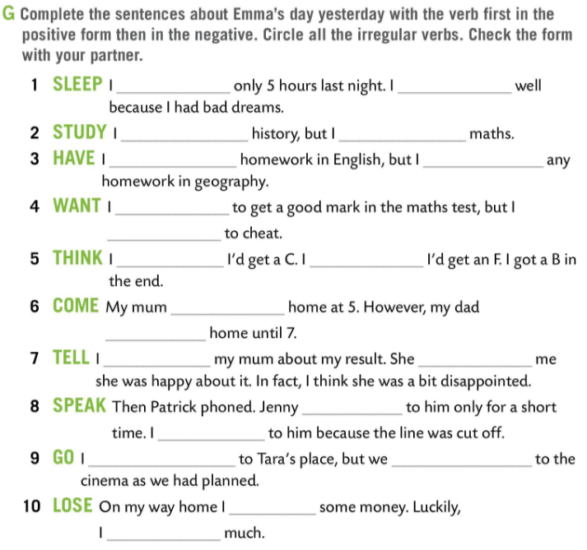
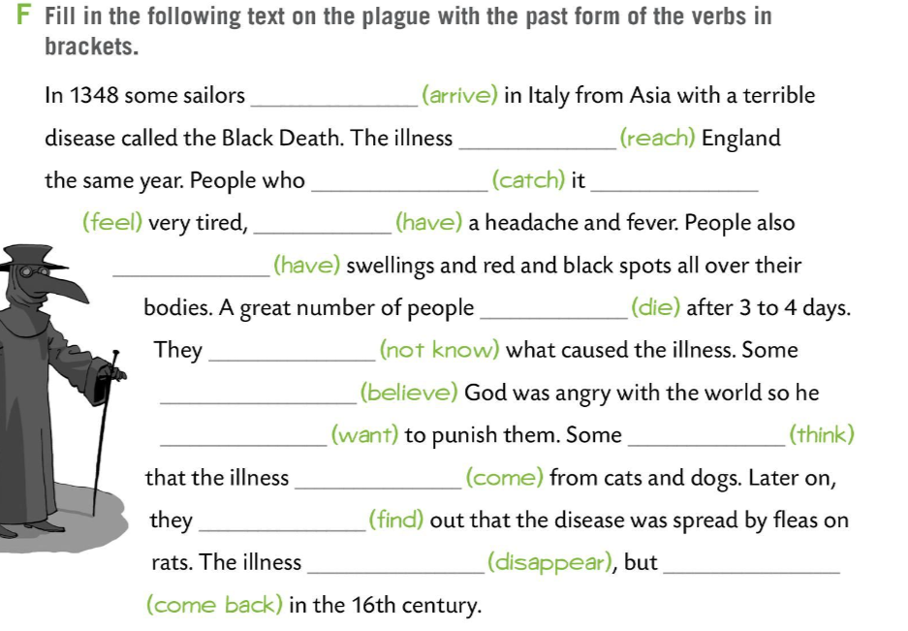
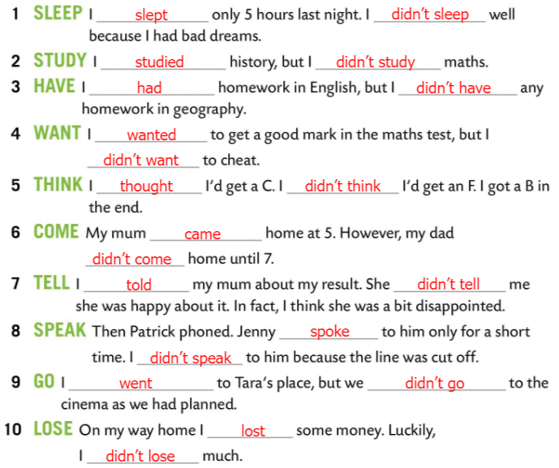
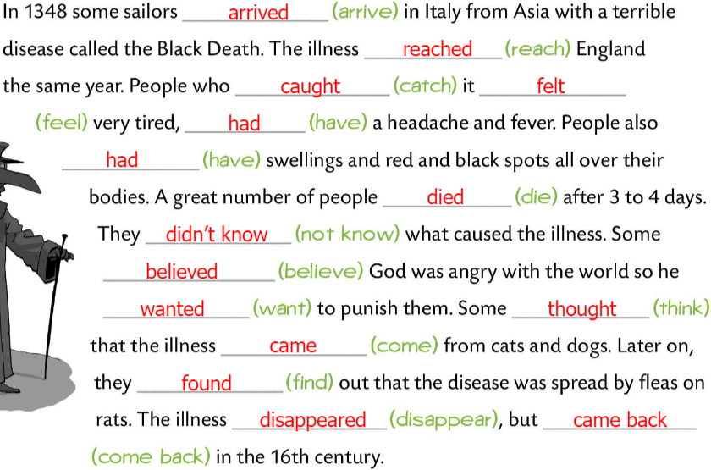
Workbook page 74.
Fill in the following text on the plague with the past form of the verbs in brackets.
Check.
Complete the sentences about Emma’s day yesterday.
First use the positive form then use the negative form.
Circle all the irregular verbs.
Check the form with your partner.
Check.

Slide 15
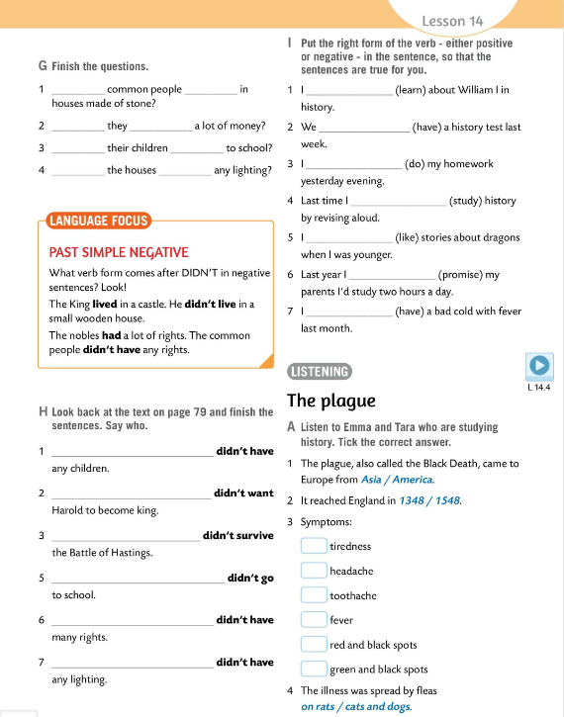
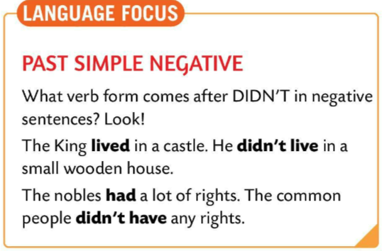
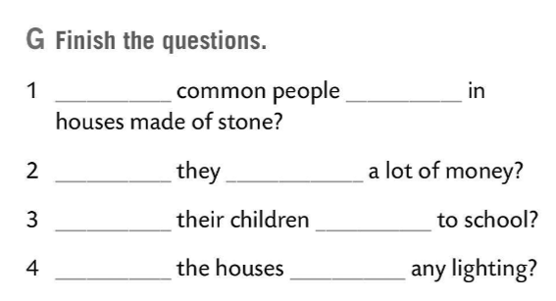
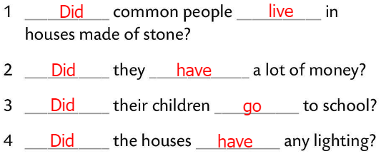
Finish the questions in Task G.
Check.
LANGUAGE FOCUS
The king didn’t live in a small wooden house.
The common people didn’t have any rights.
subject + DIDN’T + INFINITIVE

Slide 16
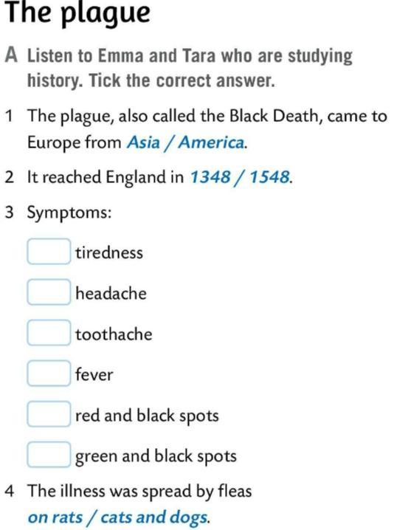
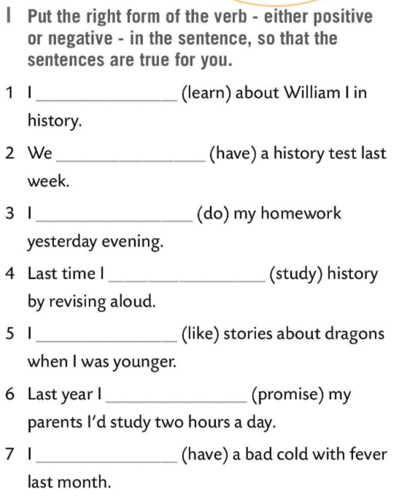
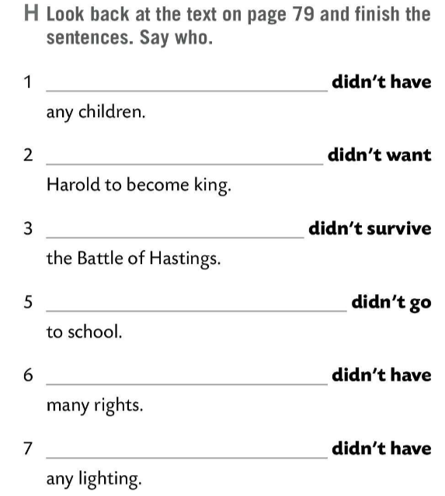
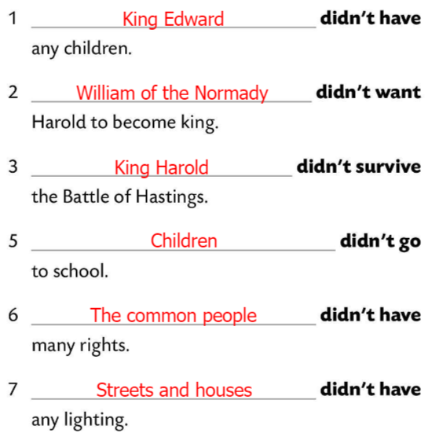


Look back at the text on page 79. Finish the sentences in Task H. Say who.
Check.
Put the right form of the verb – either positive or negative – in the sentence, so that the sentences are true for you.
Listen to Emma and Tara who are studying history. Tick the correct answer.
Check.

Slide 17
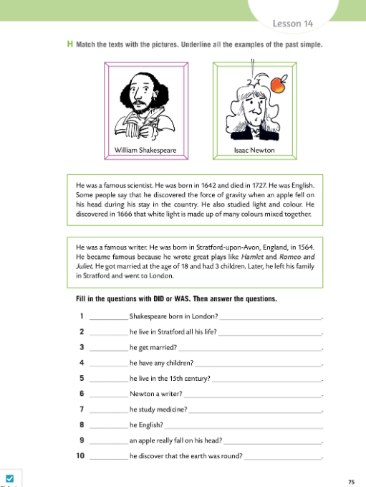
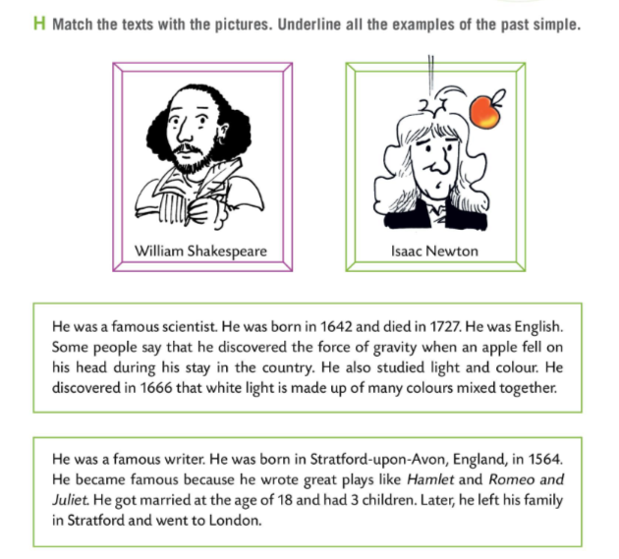
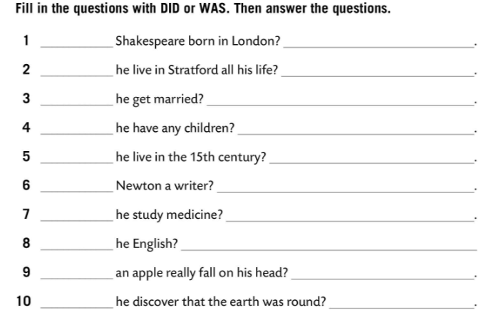
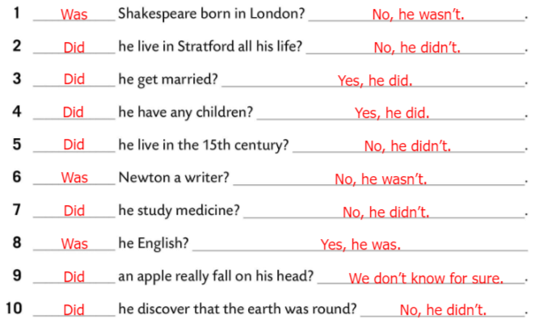
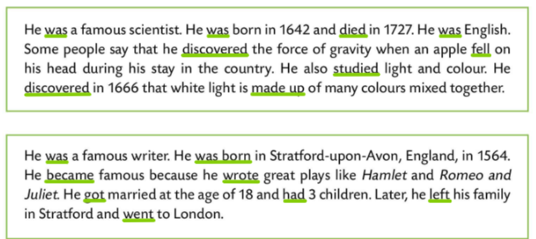
Workbook page 75.
Match the texts with the pictures. Underline all the examples of the past simple.
Check.
Fill in the questions with DID or WAS. Then answer the questions.
Check.

